Slide 1
So you need to build a login box?!
Peter Fernandez
Principal Developer Advocate, Auth0
Jessica Temporal
Senior Developer Advocate, Auth0

Slide 2
Introduction
Peter Fernandez
Principal Developer Advocate, Auth0 https://www.linkedin.com/in/pgfernandez
As an Architect, Consultant and Engineer, Peter has more than 30 years of experience designing and developing secure and robust software solutions. When not helping teams with the complexities of Customer Identity, you can usually find him working behind the scenes, acting in, or directing a show at his local theatre.
Jessica Temporal
Senior Developer Advocate, Auth0 https://jtemporal.com/socials
Focused on Python, Jess is passionate about sharing knowledge and teaching others. She had a solid experience both in web development and data science over the past decade. When not working she can be found playing cozy games or knitting some new project.

Slide 3
But should you build a login box!?

Slide 4
Management
Authentication
Authorization
Protection
Core aspects of Auth0 Customer Identity
Branding
Monitoring
Deployment

Slide 5
Partnering with a proven provider: Customer Identity
powered by
Auth0.
Architected for high resiliency
Zero planned downtime
Redundancy at every layer
Control over Release/Rollback
Always-On
Extensive and audited security controls
Seamless Scalability
Modern Security Shield
Multi-layer encryption architecture
Industry, Regulatory & Data Residency Compliance
Elastic architecture
Sophisticated capacity planning
Distributed global footprint
Dedicated Resource Options
Traffic Burst & Expansion
Secure
by Design
Built
for Scale

Slide 6
Management
Authentication
Authorization
Protection
Branding
Monitoring
Deployment

Slide 7
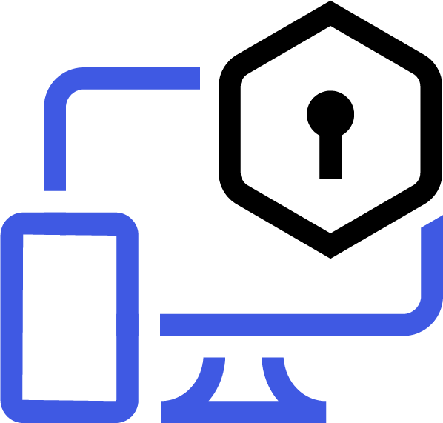
Authentication (a.k.a. AuthN)
Proving you are who say you are
Passwordless
Sign Up
Social
Enterprise
Federation
MFA
SSO

Slide 8
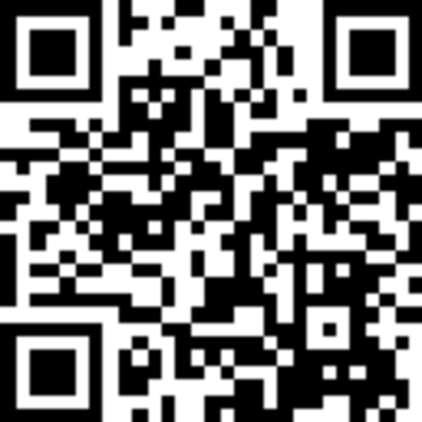
Time for a Demo
Scan the QR Code or follow the link for additional resources
https://a0.to/code/auth

Slide 9
Management
Authentication
Authorization
Protection
Branding
Monitoring
Deployment

Slide 10
Authorization (a.k.a. AuthZ)
The ability to determine exactly what's allowed
Access Consent
Open Authorization (a.k.a OAuth 2.0) Delegated Authorization: the key to building secured Application Program Interfaces (APIs).
Access Control
A factor of both Consent and Permission, this is the determination of exactly what is allowed based on the Policy(s) defined.

Slide 11
Time for a Demo
Scan the QR Code or follow the link for additional resources
https://a0.to/code/auth

Slide 12
User Data Management

Slide 13
User Data
Data from the consumer communities that are the life-blood of your commercial success.
User Account
The specific definition for a user that correlates to a particular method of authentication.
Represents the overarching definition for a user and all the associated information that pertains
User Profile
The personal details - such as a name, email address etc. - and the preferences that a user can take with them however they login.
Would also include any application specific and/or user modifiable metadata that’s unique to a particular situation.
User Credentials
The UserID and Password information that is used to authentication a user in a classic login scenario.
Storage that’s managed separately and with an additional degree of encryption for protection against attack.
Facebook
Facebook
Facebook
Google
Google
Google
UserID & Password
UserID & Password
UserID & Password

Slide 14
What’s Next?
Where to go from here

Slide 15
Recap
Authentication
The process of providing a secure, convenient, consistent and reliable context for access, based on verified credentials.
Authorization
Providing the ability to determine exactly what's permitted from a feature, function, or information perspective.
Users Data Management
The internal representation of the various consumer communities that are the life-blood of your commercial success.
https://a0.to/code/authn
https://a0.to/code/authz
https://a0.to/code/users

