Slide 1
Welcome!
Q1 Release Roundup

Slide 2
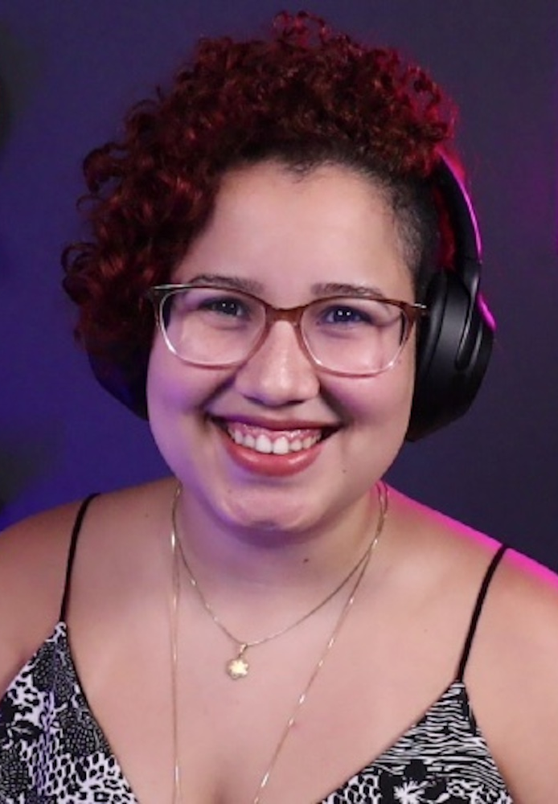
Jess Temporal
Sr Developer Advocate
jtemporal.com/socials

Slide 3
Developer Releases Guide
Notes:
https://a0.to/developer-release-guide

Slide 4

Abbie Carlson
Sr Product Marketing Manager
linkedin.com/in/abbiecarlson
Notes:
https://a0.to/developer-release-guide

Slide 5
Passkeys
Notes:
https://a0.to/passkeys-ga

Slide 6
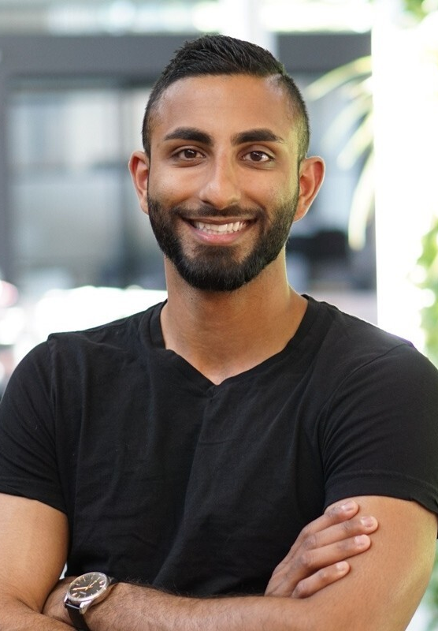
Salman Ladha
Sr Product Marketing Manager
linkedin.com/in/salmanladha
Notes:
https://a0.to/passkeys-ga

Slide 7
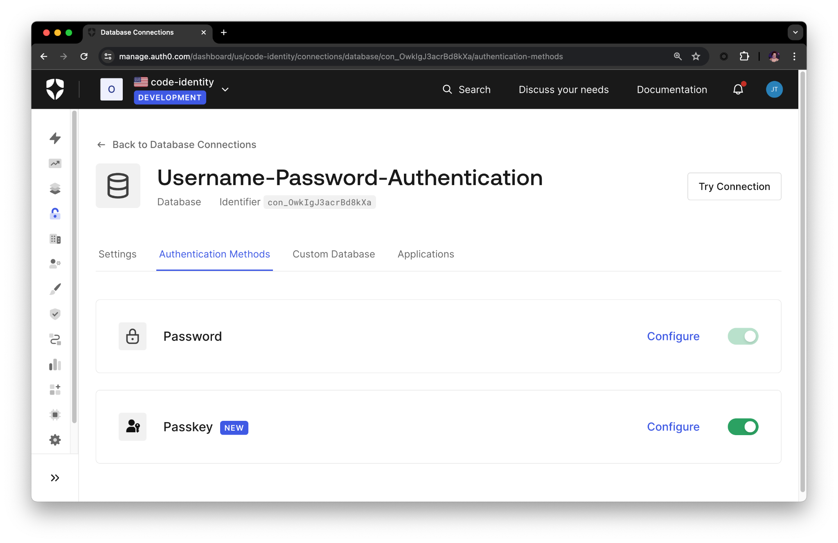
Time for a demo!
Notes:
https://a0.to/flask-authn
https://learnpasskeys.io/

Slide 8
Auth0 Guardian App
Notes:
https://a0.to/otp-enrollment

Slide 9
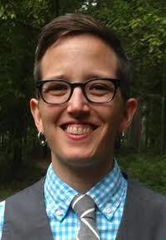
Jessie Jacobson
Sr Product Manager
linkedin.com/in/jessie-jacobson-minneapolis
Notes:
https://a0.to/otp-enrollment

Slide 10
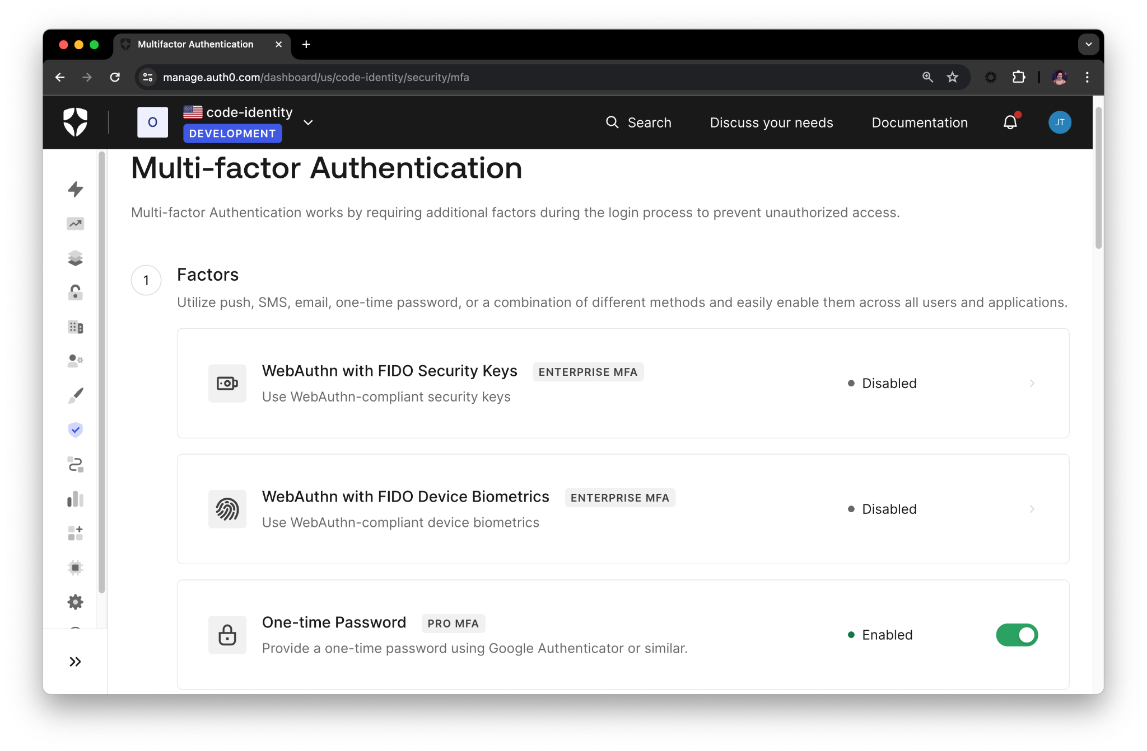
Time for a demo!
Notes:
https://a0.to/otp-enrollment
https://a0.to/flask-authn

Slide 11
Q&A
Abbie Carlson
Jessie Jacobson
Salman Ladha
Jessica Temporal
Notes:
https://a0.to/code-identity-q1-roundup

Slide 12
Recap
Developer Releases
Passkeys
Guardian App
Notes:
https://a0.to/code-identity-q1-roundup

Slide 13
Thank you
a0.to/code-identity-q1-roundup
Notes:
https://a0.to/code-identity-q1-roundup

