Slide 1
ng-conf 2019
Day 1 Keynote
Brad Green
Igor Minar
@BradlyGreen
@IgorMinar

Slide 3
Angular Products
Angular
Protractor
Forms
PWA
Augury
Language Services
Router
Elements
CDK
Universal
Karma
Labs
Compiler
i18n
Http
Material
Animations
CLI

Slide 4
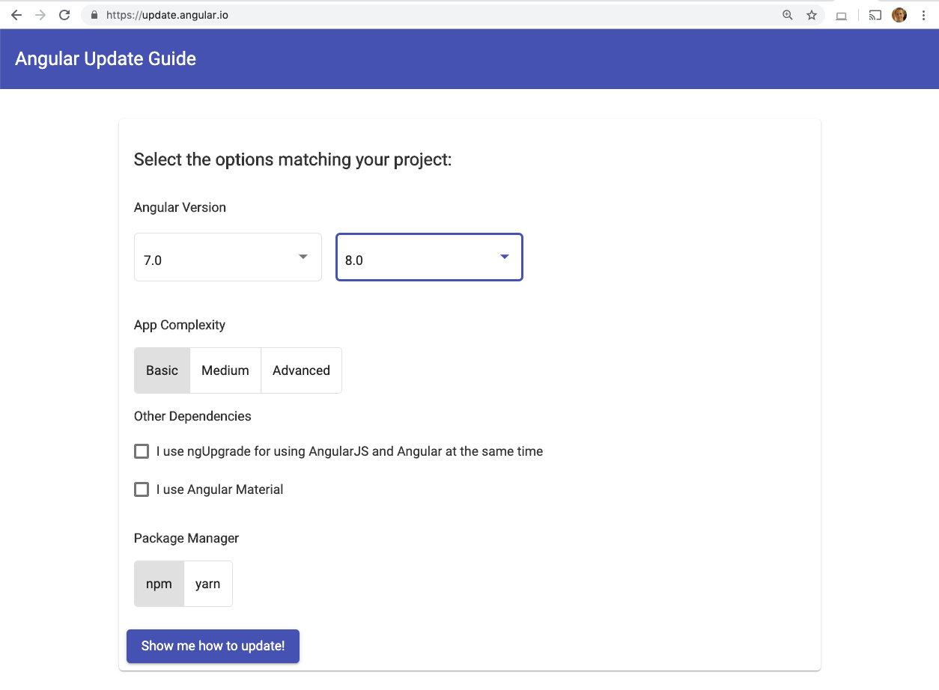
Frictionless Updates
Notes:
Upgrade story going from Angular v5 to v8 in 3 days https://twitter.com/eugeniyoz/status/1122438248847089664

Slide 5
ng update @angular/cli @angular/core
Notes:
API docs: https://angular.io/cli/update

Slide 6
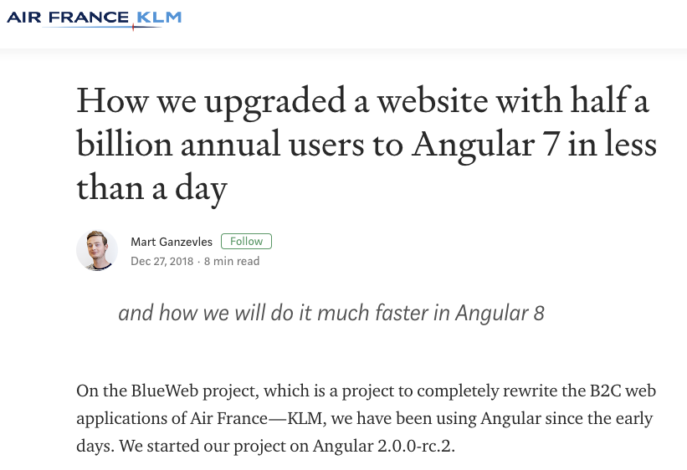
The Update Experience
Notes:
https://medium.com/airfrance-klm/how-we-upgraded-a-website-with-half-a-billion-annual-users-to-angular-7-in-less-then-a-day-71de33a1108e

Slide 7
We believe that the best measure of a healthy codebase and development team, is the time it takes from wanting a change to the time it is developed and deployed in production.
Mart Ganzevles

Slide 8
Air France / KLM Upgrade times
30d
30
20
Time in Days
14d
14d
10
1d
0
v2 to v4
v4 to v5
v5 to v6
v6 to v7
Angular Versions

Slide 9
Angular Community

Slide 10
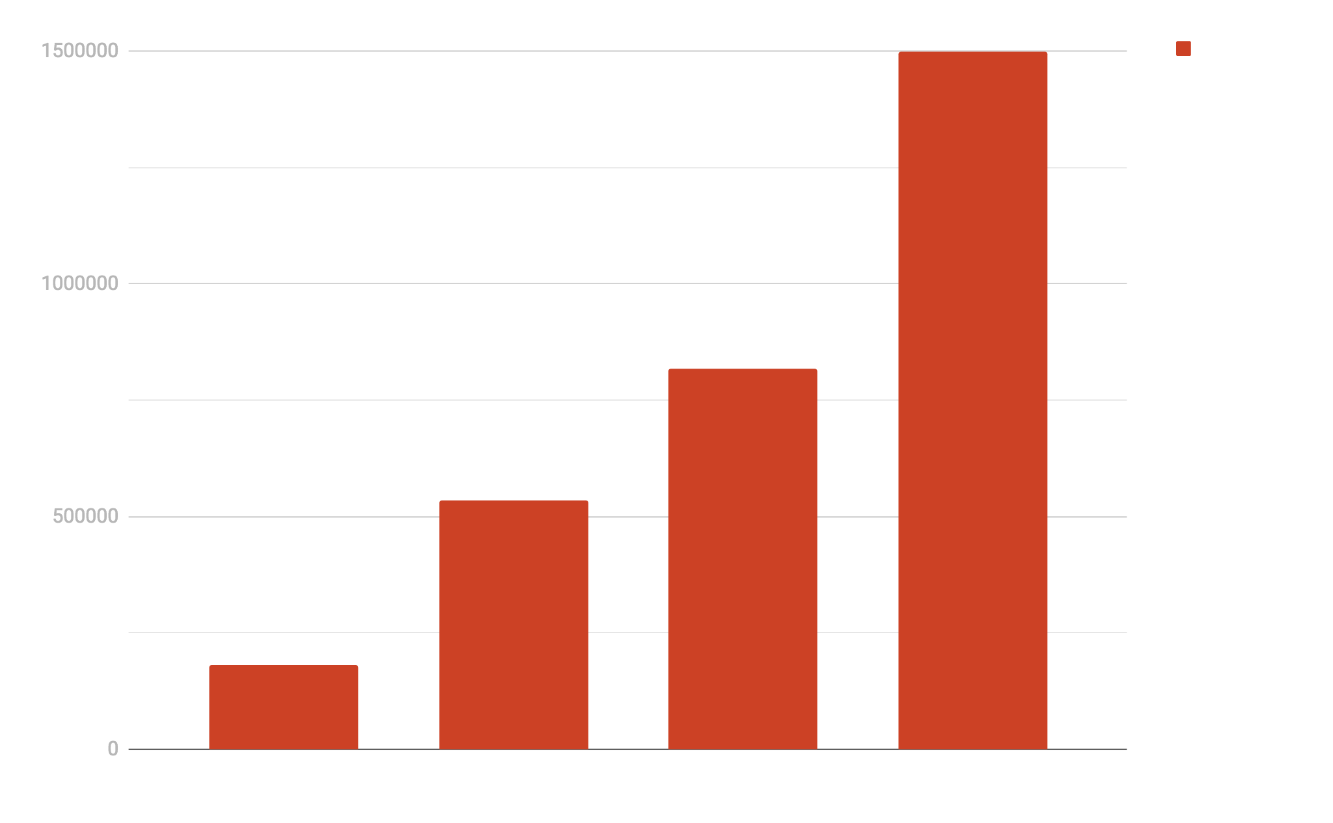
angular.io grew >50% in 2018
2015
2016
2017
2018

Slide 11
Daddy, did you pick your nose when you were a kid?

Slide 13
It’s just a compliment after all!
Thursday 3:00 PM
Grand Ballroom B
How tech communities can change your life
Friday 11:47 AM
Grand Ballroom

Slide 14
Angular Version 8 RC

Slide 15
Timeline
Today
~May
Q4
Version 8 RC
Version 8 Final
Version 9

Slide 16
Try Version 8 RC
update.angular.io
next.angular.io
Instructions
Docs
Notes:
Upgrade instructions: update.angular.io
Version 8 docs: next.angular.io (will become just angular.io once we reach final release)

Slide 17
Smaller apps with Differential Loading
Minimal polyfill
Modern syntax
Evergreen
Full polyfill
ES5 syntax
Legacy
Notes:
https://next.angular.io/guide/deployment#differential-loading

Slide 18
Differential Loading Savings
Before
41Kb
7-20%
After
For angular.io
Notes:
https://next.angular.io/guide/deployment#differential-loading

Slide 19
More Features
Builders
Deploy
Web Workers
Service Worker Improvements
Lazy Loading Via import()
AngularJS $location Support
Better IDE Completions
Simplified “Getting Started” Guide
Notes:
Builders: https://blog.angular.io/introducing-cli-builders-d012d4489f1b
Deploy: https://github.com/angular/angularfire2/pull/2046 (work in progress)
Web Workers: https://next.angular.io/guide/web-worker
Lazy loading via import(): https://next.angular.io/guide/deprecations#loadchildren-string-syntax. Perform this automatically for your app with the angular-lazy-routes-fix tool!
Simplified “Getting Started” Guide: https://next.angular.io/getting-started

Slide 20
Work in progress

Slide 21
Build like Google with Bazel

Slide 22
Shifting Development Landscape
Java, C#, etc.
JavaScript
COMPLEXITY
COMPLEXITY

Slide 23
Bazel Benefits
Incremental build and test
Full-stack
Scale on the Cloud
Notes:
Your build and test can be incremental: a small change requires a proportionally small rebuild
Compile, test, and deploy your frontend and backend code together. type-check schema uses
Much faster CI: Bazel caches intermediate build artifacts, but in case of massive cache miss, use hundreds of remote CPUs

Slide 24
Bazel Users
Google
Lucidchart
LogiOcean
Angular

Slide 25
Angular Products
Angular
Protractor
Forms
PWA
Augury
Language Services
Router
Elements
CDK
Universal
Karma
Labs
Compiler
i18n
Http
Material
Animations
CLI

Slide 26
Angular framework CI faster with RBE
4000
60 min
3000
2000
1000
7.5 min
0
Before RBE
After RBE
Notes:
For angular's own build & test on CircleCI

Slide 27
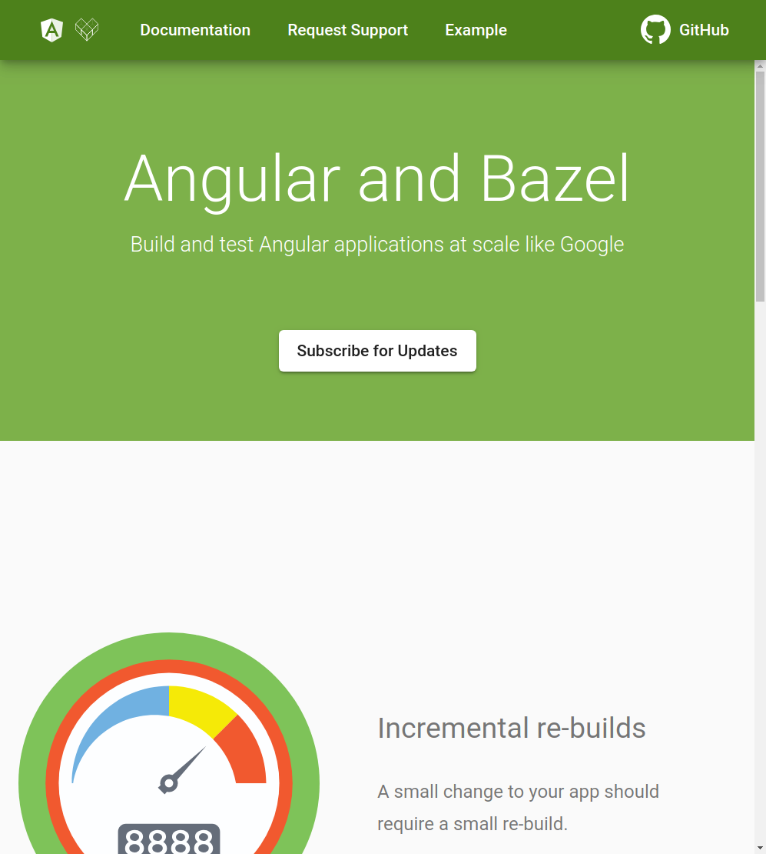
Run Bazel in the CLI
Notes:
bazel.angular.io

Slide 28
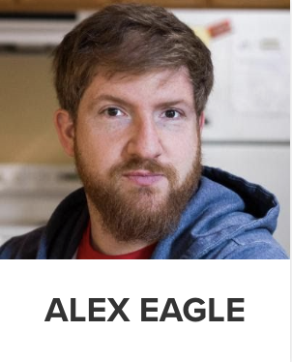
Get all the Bazel details
The Bazel Opt-In Preview is Here
Friday 1:30 PM
Grand Ballroom

Slide 29
Bazel team is here at ng-conf!
Wednesday: 10am - 1:30pm
Expo hall at the Google Cloud & Firebase table
Thursday: 1 - 3pm
Bagatelle (3rd floor)
Friday: 10am - 1:30pm
Expo hall at the Google Cloud & Firebase table

Slide 30
Ivy Renderer
Smaller
Faster compilation
Simpler debugging
Improved type checking
Backwards compatible

Slide 31
Try Ivy in Version 8 RC
ng new my-app --enable-ivy
next.angular.io/guide/ivy
Notes:
next.angular.io/guide/ivy

Slide 32
Ivy @ Google
97%
Passing unit, integration, and screenshot tests
Representing hundreds of thousands of tests across Google apps using Angular

Slide 33
Backwards Compatibility for You
Few dependencies
Many dependencies
Low risk
Higher risk

Slide 34
Simpler Debugging in Version 8 RC
Breakpoints in HTML
Debuggable change detection

Slide 35
Smaller
Recommended
Help us test!
160
120
90
Thrill seekers
60
30
151kB
131kB
126kB
109kB
14kB
0
View Engine
View Engine + Differential
Ivy Compat
Ivy Compat + Differential
Ivy Future API + Differential
Angular hello world app, minified, uncompressed
Notes:
For "hello world" CLI app (master):
VE: 151 kB
VE + differential: 131 KB
Ivy compat: 126 kB (17% smaller)
Ivy compat + differential: 109 kB (17% smaller)
Ivy non-compat: 14kB (91% smaller)

Slide 36
BONUS: Lower memory requirements
Application simulation
30%
Material unit tests
memory
91%
Angular Test Suites
Notes:
Application without styles (100 x 100 table) - profile using Chrome Dev Tools:
Total memory (KB): 30% down
Application with style bindings (100 x 100 table) - profile using Chrome Dev Tools:
Total memory (KB): 55% down

Slide 37
BONUS: Faster tests
Framework unit tests
time
38%
Material unit tests
time
80%
Angular Test Suites
Notes:
Framework unit tests: 38% faster (average: 15.3 seconds vs 9.5 seconds)
Material unit tests: 80% faster (average: 342.1 seconds vs 69.4 seconds)
Material unit test memory: 91% smaller (average: 1640 MB vs 144MB)

Slide 38
BONUS: Fixed Long Standing Bugs
Class bindings override other classes
Change detection runs too often
ContentChildren queries select host node
Queries have inconsistent resolution timing
Descendants flag works inconsistently
Notes:
Change detection runs too often - Change detection still running for detached components that are projected (21324)
Class bindings always override other classes (7289)
Confusing query behavior
ContentChildren queries select host node (10098)
Queries have inconsistent resolution timing (21800, 25961)
Descendants flag works inconsistently (14769, 27504)

Slide 39
Ivy Renderer
Simpler debugging
Backwards compatible
Lower memory
Faster tests
Bug fixes

Slide 40
Ivy Renderer
Smaller
v9
Faster compilation
v9
Improved type checking
v9

Slide 41
Version 9 (Q4 2019)
Ivy as Default
Bazel in CLI
Fully Featured & Stable

Slide 42
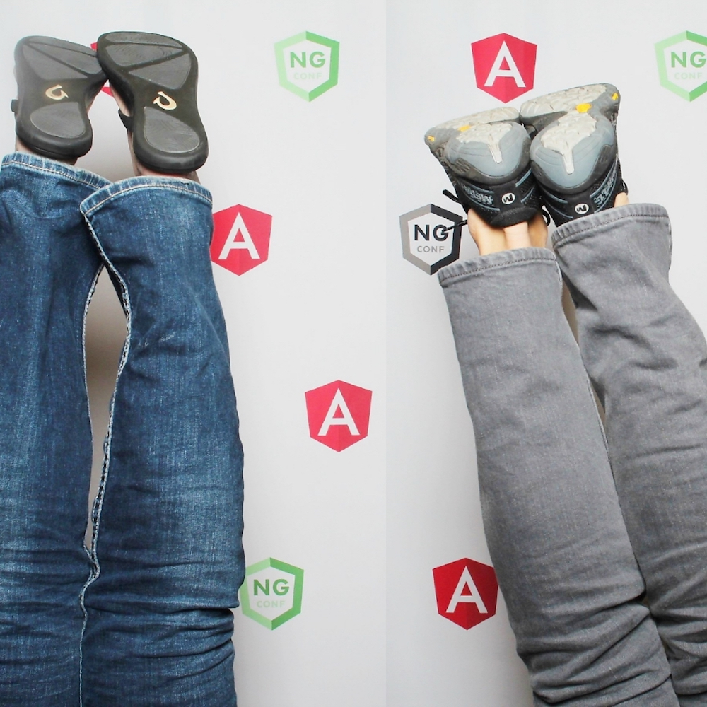
Design considerations + Community
Igor Minar
Angular Tech Lead

Slide 43
Compatible
Notes:
No users left behind

Slide 44
Angular
is an ecosystem that
you can rely on.
Notes:
No users left behind

Slide 45
Evergreen
Notes:
No users left behind

Slide 46
Angular
is an ecosystem that
is malleable and ever-evolving.
Notes:
No users left behind

Slide 47
Scalable
Notes:
No users left behind

Slide 48
billions
Billion user apps
Number of users
Enterprise
apps
Small apps
Demos
Edu apps
0
Number of apps
millions

Slide 49
billions
Billion user apps
AngularJS
(est 2010)
Number of users
Enterprise
apps
Small-medium apps
Demos
Edu apps
0
Number of apps
millions

Slide 50
billions
Billion user apps
Angular v2
(est 2016)
Number of users
Enterprise
apps
Small-medium apps
Demos
Edu apps
0
Number of apps
millions

Slide 51
billions
Billion user apps
Angular v2 actual
(est 2016)
Number of users
Enterprise
apps
Small-medium apps
Demos
Edu apps
0
Number of apps
millions

Slide 52
billions
Billion user apps
Angular v4-v8
(2016-2019)
Number of users
Enterprise
apps
Small-medium apps
Demos
Edu apps
0
Number of apps
millions

Slide 53
billions
Billion user apps
Angular Ivy
(planned for v9)
Number of users
Enterprise
apps
Small-medium apps
Demos
Edu apps
0
Number of apps
millions

Slide 54
billions
Billion user apps
Angular Photon
(prototypes)
Number of users
Enterprise
apps
Small-medium apps
Demos
Edu apps
0
Number of apps
millions

Slide 55
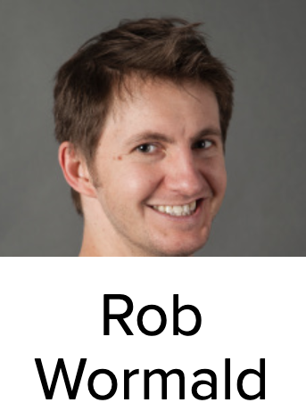
Web Components with Angular Elements: Beyond the Basics
Today 10:50 AM
Not Every App is a SPA
Today 3:55 PM

Slide 56
billions
Billion user apps
Angular Photon
(prototypes)
Number of users
Enterprise
apps
Small-medium apps
Demos
Edu apps
0
Number of apps
millions

Slide 57
Hello Friends!

Slide 58
Angular
is an ecosystem that
is people-oriented
Notes:
No users left behind

Slide 61
Values
Apps that users ❤ to use
Apps that developers ❤ to build
Community where everyone feels welcome

Slide 62
Angular
is
open-source
Notes:
No users left behind

Slide 63
❤
OSS

Slide 64
OSS
Developed on GitHub
CI with Google
(Google runs on development HEAD)

Slide 65
OSS

Slide 66
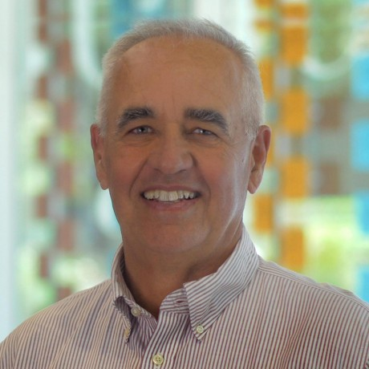
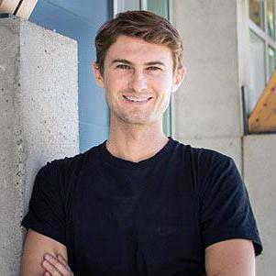
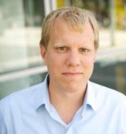
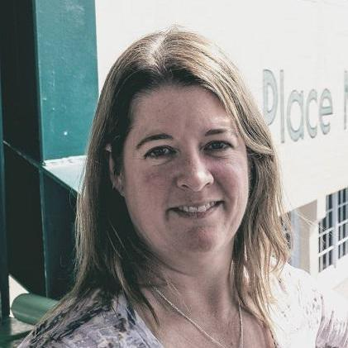
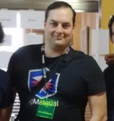
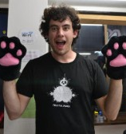
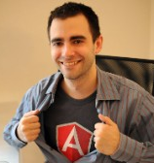
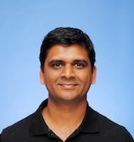
43 Amazing People

Slide 67
Angular Team
Developer Relations
Tooling
Framework
Components
Documentation

Slide 68
Angular Organization
Googlers
(with access to google3)
Team
Collaborators
PR Contributors &
Issue Reporters
Community

Slide 69
Angular Collaborators
Program for scaling Angular development through the Angular community

Slide 70
Angular Organization
Googlers
(with access to google3)
Team
Collaborators
PR Contributors &
Issue Reporters
Community

Slide 71
Scaling with OSS via Angular Collaborators
Googlers
Team
Existing Collaborator
New Collaborators
PR Contributors &
Issue Reporters
Community

Slide 72
Angular Collaborators
Enterprise
Enable enterprises to invest into Angular in exchange for inhouse expertise, and ability to inform the roadmap
Community
Enable individuals turn their passion into impact

Slide 73
Angular Collaborators: Goals
Scale via OSS
Increase Team Diversity
Engage with the Community
Create Opportunities
Ensure Long Term Success

Slide 74
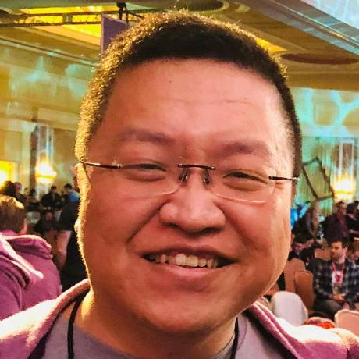
9 New Community Collaborators
Adam Plumer
Cédric Exbrayat
Deborah Kurata
Jason Bedard
JaiLi Passion
Joost Koehoorn
Manfred Steyer
Markus Padourek
Sam Julien

Slide 75
~40 more in 2019

Slide 76
Angular GDE
Angular Collaborator

Slide 77
Not just to code contributions
Docs
Triaging / Support
Design / UX Research

Slide 78
How to Join?
Community: Be an awesome contributor
Enterprise: devrel@angular.io

Slide 80
Empathy and Respect

Slide 81
Enjoy ng-conf!

Slide 82
Thank You!
g.co/ng/ng-conf-2019-keynote1
@BradlyGreen
@IgorMinar

